Slide 1
Real-Time stock market data web application
- Milind Rathore
INDIAN INSTITUE OF TECHNOLOGY ROPAR

Slide 2
Index
Introduction
Key Features
Tools and Techniques
Path-flow of Working of Project
Challenges
Documentation
Conclusion

Slide 3
Overview of the project synopsis
Project Description:
The Real-Time Stock Market Data Web Application is a full-stack web application that allows investors to track real-time stock market data in an easy-to-understand format. The web application pulls real-time stock market data from APIs and displays stock prices, volume, market trends, and other information that investors need to track their investments. The web application has features such as user authentication and security to ensure that user data is protected.

Slide 4
Task instructions
Key Features:
Real-time stock market data
User Authentication and Security
Easy-to-Understand Format
Responsive Design

Slide 5
Why do we need this ?
It Gives Very Precise Information
Data Updates On Every Seconds
Company-Investor Interaction

Slide 6
Tools & Techniques
Front-end
HTML, CSS, JavaScript, React.js
Back-end
Node.js, Express.js, MongoDB
Api’s
Alpha Vantage API, News API

Slide 7




Front - end
I
II
III
IV
HTML
CSS
JavaScript
React.js
It creates structure on the web from page layouts and paragraphs to links, tags and attributes.
To style and layout web pages
It allows us to add dynamic behavior to the webpage and add special effects to the webpage.
It is an open-source JavaScript framework. Used for building interactive user interfaces and web applications quickly and efficiently with significantly less code than you would with vanilla JavaScript.

Slide 8
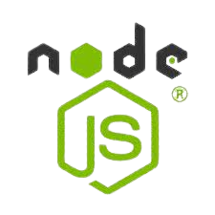


Back - end
Node.js
Express.js
Mongo-db
Superpower of Node.js is the fast processing of real-time requests in parallel. But there is a limitation on the overall size of the app: Node.js is only good for small applications with the same light requests.
It allows to handle large amounts of traffic with ease. Express.JS is highly flexible and can be used to build a wide range of web applications, from simple websites to complex APIs.
Data-Base Manager It facilitates storing nested data that can be used to store complex data patterns in the same documents. This makes it easier to fetch data and work on it.

Slide 9
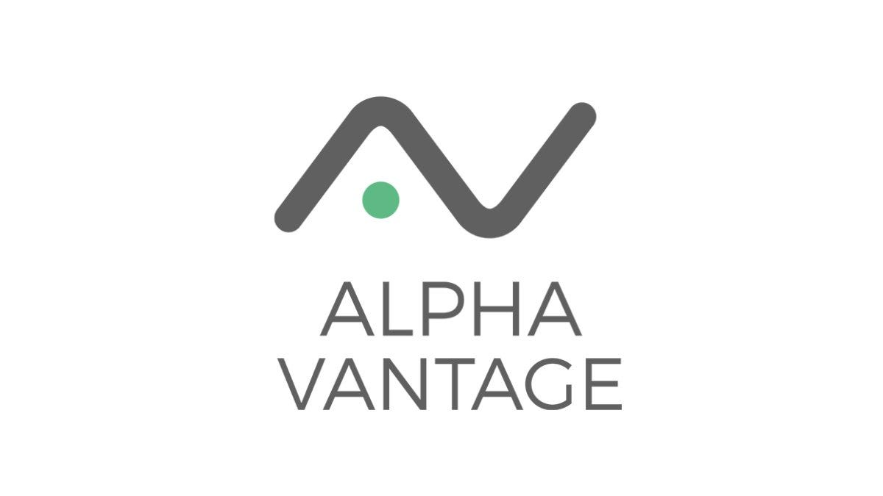

Api’s
I
II
Alpha Vantage Api
News Api
Alpha Vantage provides enterprise-grade financial market data through a set of powerful and developer-friendly data APIs and spreadsheets.
The main use of News API is to search through every article published by over 80,000 news sources and blogs in the last 5 years.

Slide 10
Path-flow of working project
Improper Credentials
Home Page
Authentication Page
Account Verification
User Interaction
Correct Credentials
Verified Account
Search Company Information
In Backend, API routing start for the request
Stock Market API Database
Data Visualization on Front-End
Response has been collected

Slide 11
Challenges
The main challenge of this project will be:-
To pull real-time stock market data from APIs and display it in an easy-to-understand format.
To implement user authentication and security features to protect user data.

Slide 12
Documentation

Slide 13
conclusions
The Real-Time Stock Market Data Web Application is an essential tool for investors who want to track their investments in real-time. The application will provide an easy-to-understand format that displays stock market data and other essential information to investors. The web application will be developed using modern web technologies such as React.js, Node.js, and MongoDB, making it a valuable addition to any full-stack web developer's portfolio.

Slide 14
references
1.
2.
3.
https://www.w3schools.com/REACT/DEFAULT.ASP
https://www.w3schools.com/nodejs/
https://www.alphavantage.co/documentation/
https://youtu.be/T26V1aSEtJE

Slide 15
THANK YOU
Milind Rathore
2020mcb1241@iitrpr.ac.in

